Slide 1
Data Visualization
9/3/2022
Lecture 2

Slide 2

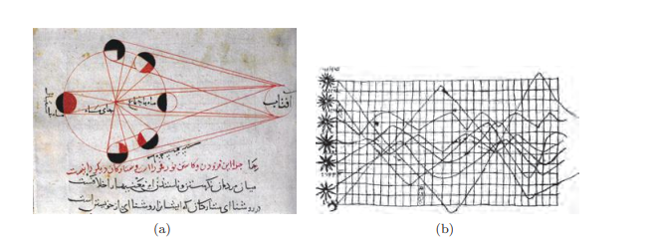

History Of Data Visualization
1600 AD
30000 YEARS
1280 AD

Slide 3
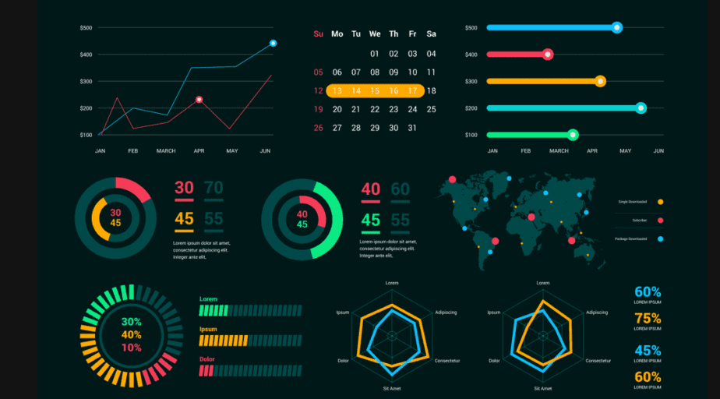
2000’S

Slide 4
Relationship between Visualization and Other Fields
Computer Graphics vs Data Visualization
Originally, visualization was considered a subfield of computer graphics, primarily because visualization uses graphics to display information via images
In all visualizations, one can clearly see the use of the graphics primitives (points, lines, areas, and volumes). Beyond the use of graphics, the most important aspect of all visualizations is their connection to data.

Slide 5
visualization is more than simply computer graphics.
The field of visualization encompasses aspects from numerous other disciplines, including human-computer interaction, perceptual psychology, databases, statistics, and data mining, to name a few.
While computer graphics can be used to define and generate the displays that are used to communicate the information, the sources of data and the way users interact and perceive the data are all important components to understand when presenting the information.

Slide 6
Computer Graphics
Our view is that computer graphics is predominantly focused on the creation of interactive synthetic images and animations of three-dimensional objects, most often where visual realism is one of the primary goals.
A secondary application of computer graphics is in art and entertainment, with video games, cartoons, advertisements, and movie special effects as typical examples.

Slide 7
Visualization
Visualization, on the other hand, does not emphasize visual realism as much as the effective communication of information.
Many types of visualizations do not deal with physical objects, and those that do are often communicating attributes of the objects that would normally not be visible, such as material stress or fluid flow patterns.

Slide 8
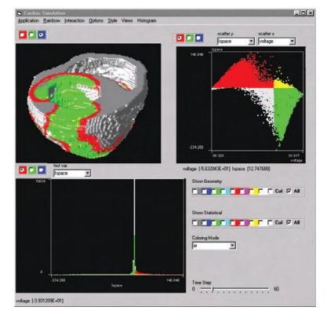
Visualization of Patient Heart
A visualization of a patient’s heart, along with visualizations representing additional parameters not easily representable on that 3D model.
The visualization in shows the dependency of interactive visualization on computer graphics
Computer graphics is the rendering engine for this integrated visualization

Slide 9
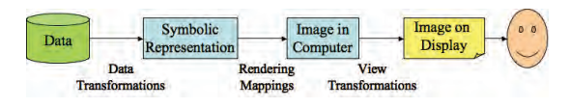
The visualization process at a very high or primitive level view.

Slide 10
7 Steps of Data Visualization
Step 1: Define a clear purpose.
Step 2: Know your audience.
Step 3: Keep visualizations simple.
Step 4: Choose the right visual.
Step 5: Make sure your visualizations are inclusive.
Step 6: Provide context.
Step 7: Make it actionable

Slide 11
Define a clear purpose
The first step toward good data visualization is to identify the problem you’re trying to solve.
What vital strategic question are you going to answer?
How will the information you’re presenting provide real value to the company?

Slide 12
Know your audience.
The visualization strategy you choose should be designed to communicate effectively with your target audience.
What is their expertise?
How will they best be able to process your data?
People consume information differently, so carefully consider their response when developing your message.

Slide 13

Keep visualizations simple
No matter your audience, it’s important to keep your visualizations as simple as possible.
The more complicated the visual, the more difficult it will be to make decisions and recommendations from its content

Slide 14
Choose the right visual
Anyone who has tried to create a chart before knows how many options are available for presenting your data.
Choosing the right one can feel like a daunting task, but it doesn’t have to be.
After you’ve identified your purpose (step 1) and audience (step 2), you know what kind of data you need to summarize.
Armed with that knowledge, you can use the guide to the right to pick an appropriate chart type

Slide 15
Make sure your visualizations are inclusive
Whenever possible, try to make sure important information is communicated in a way that doesn’t rely entirely on color.
This will allow your data to be understood by the broadest possible audience.
Inclusive design doesn’t mean eliminating color — it just means working to ensure your graphics can be understood with or without it.

Slide 16
Provide context
Instead of just presenting your data, connect it to a broader context. What does it mean for the problem or subject being assessed?
Make sure it’s easy to interpret the information quickly and apply it in the context of a particular challenge.

Slide 17
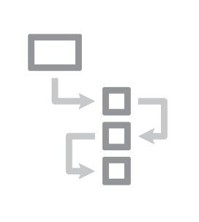
Make it actionable
Finally, and perhaps most importantly, make sure the data you’re sharing is actionable.
The best visualizations can turn insights into action by allowing your audience to use data to inform their strategies and business decisions

